Slide 1
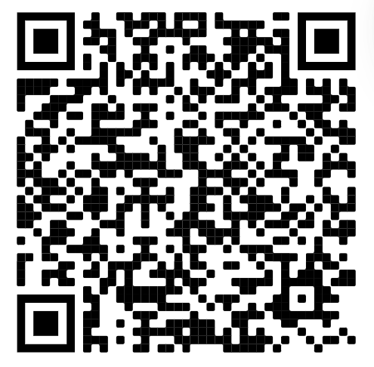
Intro to API’s
Sign in —>

Slide 2
The problem or challenge
Announcements
Johnson & Johnson is hosting a virtual networking event Mon Nov 7th (great for comp bio majors!)
Any help scheduling classes, just ask!
Grab your WiCS Formal tickets!!! It will be super fun!
WPU ticket booth
Cash or panther funds
$10 a ticket
Drinks and appetizers will be served
Bring anyone as long as they have a ticket!

Slide 3
So… what is an API?
a set of functions and procedures allowing the creation of applications that access the features or data of an operating system, application, or other service.
But to put it simply, a way for softwares to exchange data or info with one another

Slide 4
Getting started
-Get access to the API!
-Download VSCode if you don’t already have it
-Get the python extension
-Make the program! Today we will be making a weather app

Slide 5
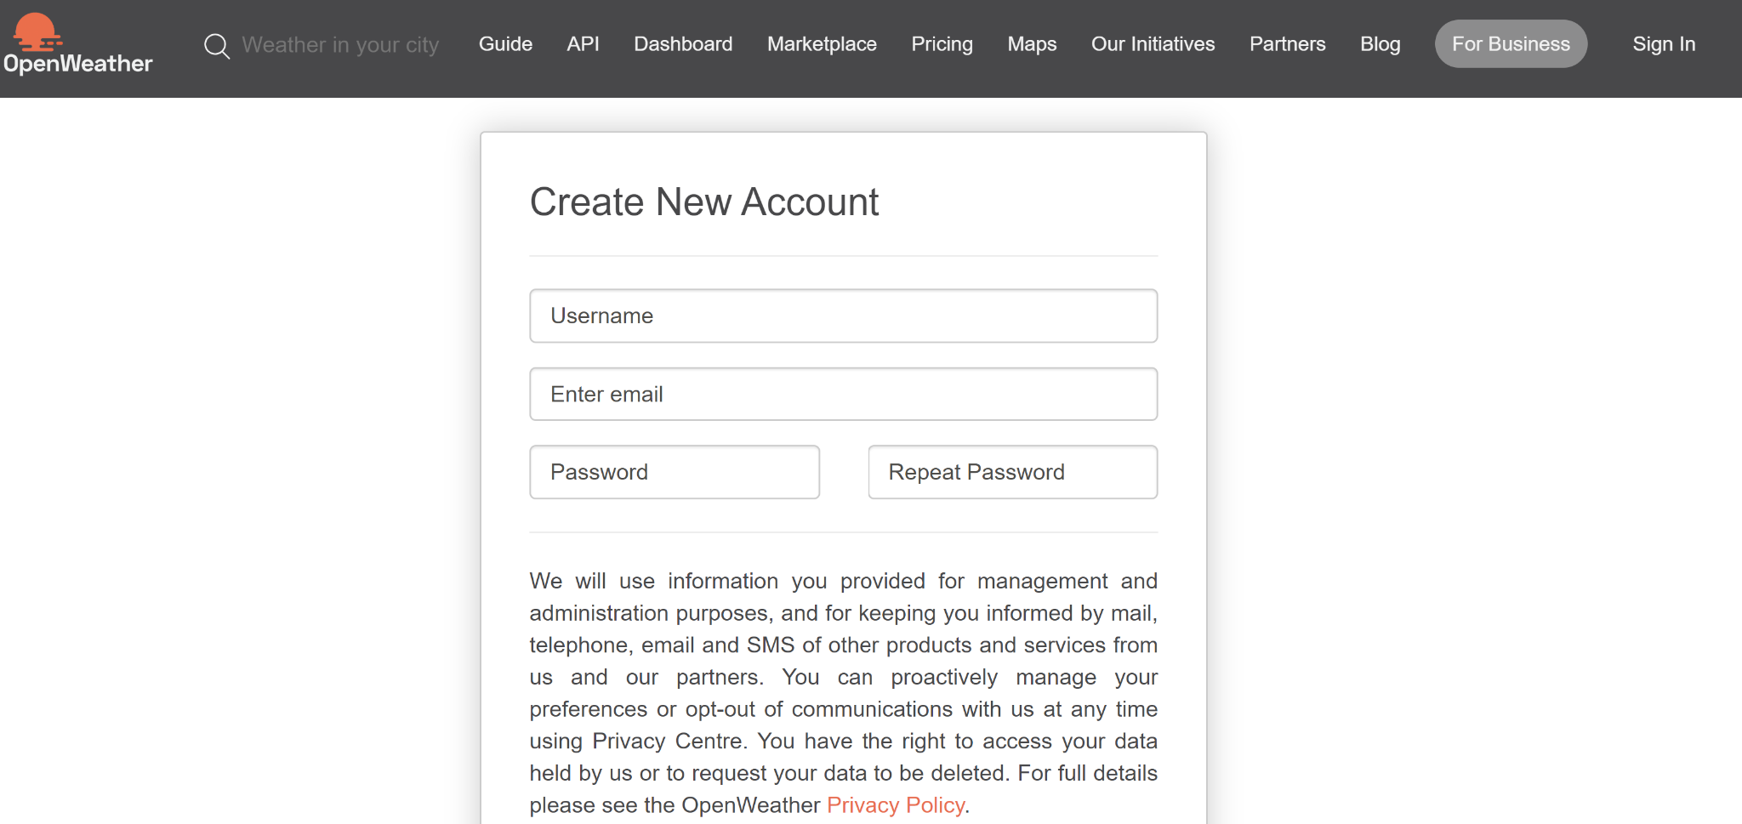
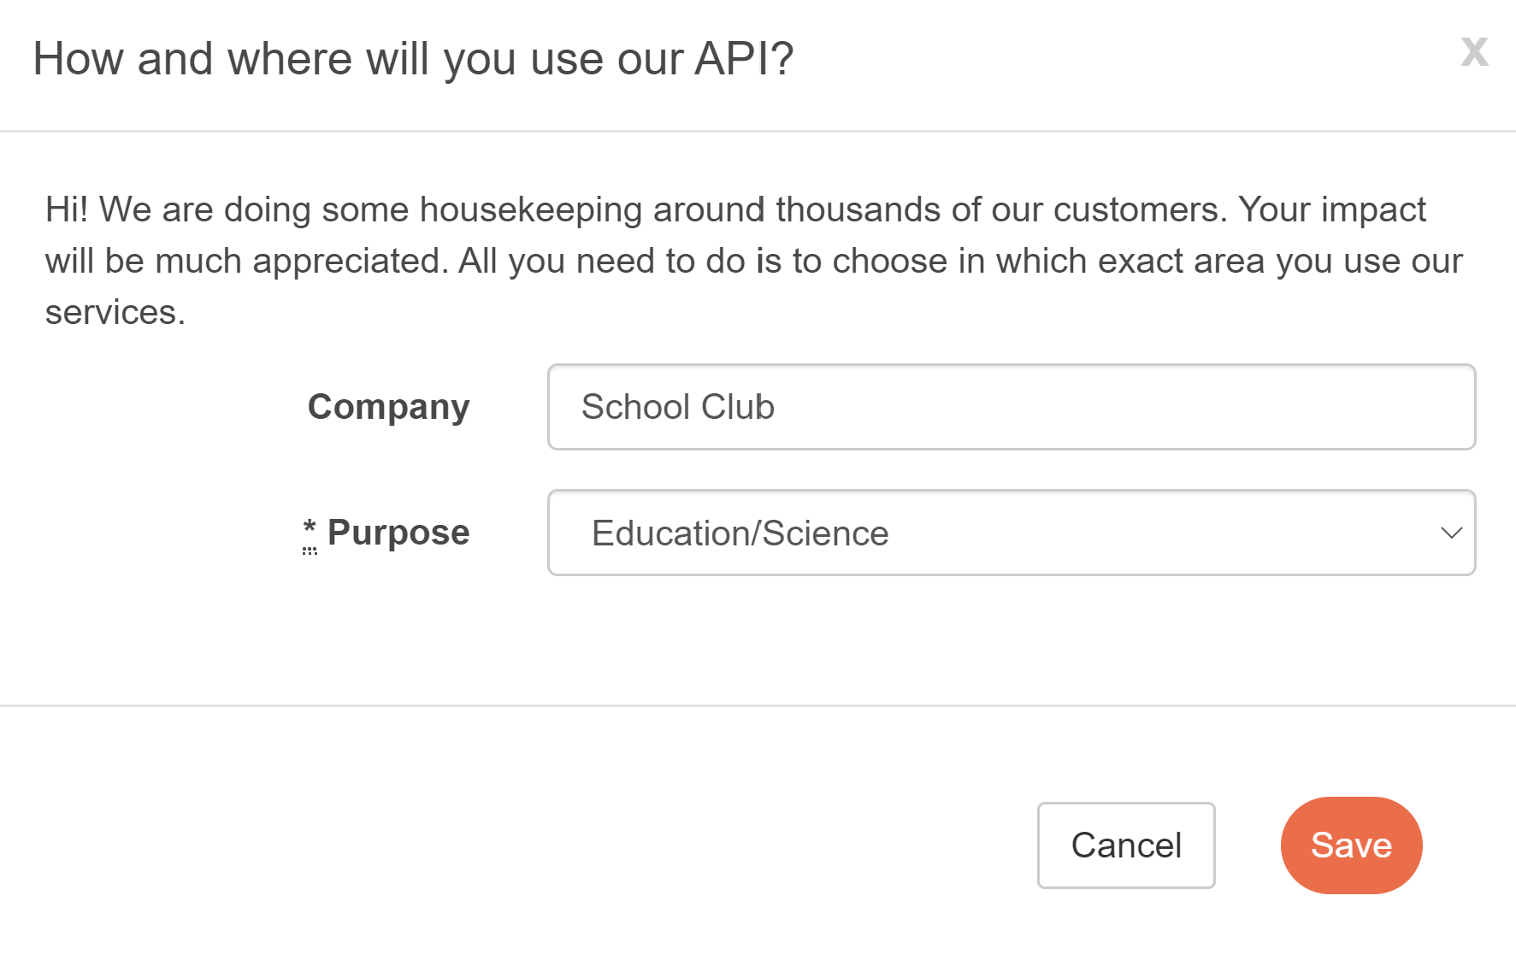
My testing method
First, let’s get our API
Head to home.openweathermap.org/users/sign_up and create an account

Slide 6
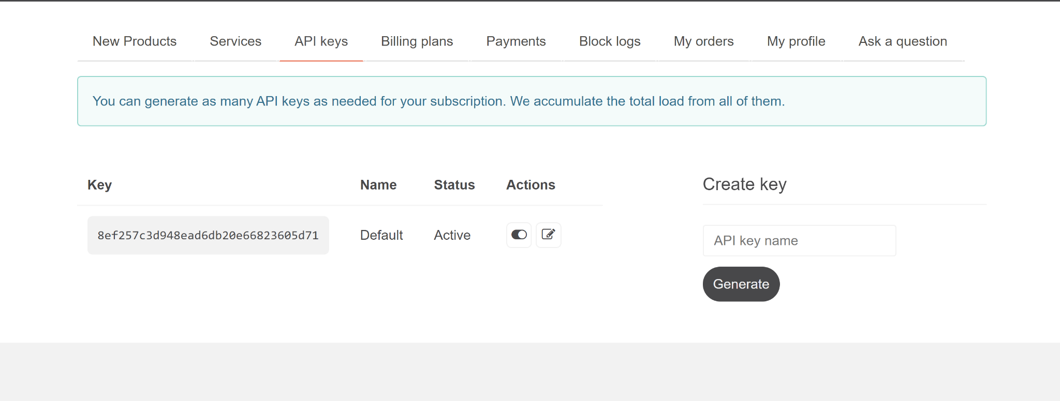
Aha! Your API is here
We will be using this shortly, don’t let go of it!
First, let’s get our editor set up for those that do not have it

Slide 7
For getting your editor, go to code.visualstudio.com/Download

Slide 8
Python Extension
Visual studio has an awesome feature where you can download extensions directly from there. Just look up Python, download, and we’re ready to make our program!

Slide 9

Now, let’s code!
Open a new file in VSCode and name it weatherapp.py

Slide 10

Slays of the Week
Sherryl (Former WiCS Business Manager)got a full time offer at Google!!!!!!!! Slay Sherryl
Shreya (our amazing vice president) accepted an internship!! Go Shreya!!
Maanya got an internship offer! SLAYYY!!!
The weather??? :)
Taylor Swift album drop
Anti-slays of the Week
Anita did not do her 1501 Assignment and now must suffer the consequences of her actions and grind out the next one
1501 exam grades came in
Only 5 people go to Maanya’s 1502

Slide 11
Thanks for joining us! Now you have a small personal project under your belt and can say you know how API’s work and how to use them!

